Slide 1
Truckee High School On-line Registration 2011-2012
Welcome to the brand new Truckee High School on-line registration process
Please have your transcript, graduation/A-G requirement check-off sheet and a pencil as you go through the following slides
Check off each completed requirement that falls under each category
At the completion of the slide-show you should have a clear idea of your remaining requirements in order to graduate and meet your future goals

Slide 2
Truckee High School On-line Registration 2011-2012
Truckee High School Graduation Requirements- 240 Credits needed
A-G CSU/UC Requirements
History/Social Science- 30 credits
1. Global Studies- 9th
2. World History- 10th
3. US History (AP)- 11th
4. Government(AP-) 12th
5. Economics- 12th
A. History/Social Science- 25 Credits
1. World History- 10th
2. US History (AP)- 11th
3. Government (AP)- 12th

Slide 3
Truckee High School On-line Registration 2011-2012
Truckee High School Graduation Requirements
A-G CSU/UC Requirements
English- 40 Credits
1. English 9 (H)- 9th
2. English 10 (H)- 10th
3. English 11 (AP)- 11th
4. English 12 (AP)- 12th
B. English- 40 Credits
1. English 9 (H)- 9th
2. English 10 (H)- 10th
3. English 11 (AP)- 11th
4. English 12 (AP)- 12th

Slide 4
Truckee High School On-line Registration 2011-2012
Truckee High School Requirements
A-G CSU/UC Requirements
Mathematics- 30 credits
1. Algebra 1A and 1B
2. Or Algebra 1
3. Geometry (H)
4. Algebra 2A
5. Consumer Math
6. Math Fundamentals
7 . Business Math
Math credits are determined on a case by case basis depending on courses taken 9-12
C. Mathematics- 30 Credits
1. Algebra 1A and 1B or Algebra 1
2. Geometry (H)
3. Algebra 2A and 2B (H)
4. Pre-Calculus- Recommended for UC

Slide 5
Truckee High School On-line Registration 2011-2012
Truckee High School Requirements
A-G CSU/UC Requirements
Laboratory Science- 20 Credits
1.9th Grade Science (H)- 9th or Chemistry
2. Biology (H)- 10th
D. Laboratory Science- 20 credits
1. Biology (H)- 10th
2. Chemistry (Adv./AP)- 11th
3. Physics (Adv.)- recommended for UC

Slide 6
Truckee High School On-line Registration 2011-2012
Truckee High School Requirements
A-G CSU/UC Requirements
Fine Arts/Foreign Language- 10 Credits
1. Foreign Language or
2. Art or
3. Band or
4. ROP Video or
5. Adv. Art/Ceramics or
6. Drama 1-2 or
7. Art Appreciation or
8. AP Art or
9. Music Appreciation
E. Foreign Language- 20 Credits
1. Spanish 1/French 1/American Sign Language 1 . . .
2. Spanish 2/French 2/ASL 2 . . .
3. Spanish 3/French 3/ASL 3 . . . Is recommended for UC

Slide 7
Truckee High School On-line Registration 2011-2012
Truckee High School Requirements
A-G CSU/UC Requirements
Electives/Other- 75 Credits
1. Vocational Education-10 Credits- Foods, Computers, Woodshop, ROP Video, Music Production, Career Exploration, Peer Tutor
2. Any class that exceeds the THS requirements i.e. Chemistry, Physics, Anatomy and Physiology, Leadership, extra PE, extra Fine Art, extra Voc Ed.
No Requirement

Slide 8
Truckee High School On-line Registration 2011-2012
Truckee High School Requirements
A-G CSU/UC Requirements
No Requirement
F. Visual/Performing Arts- 10 Credits
Choose one from below
1. Symphonic Band
2. Art
3. ROP Video
4. Drama 1-2

Slide 9
Truckee High School On-line Registration 2011-2012
Truckee High School Requirements
A-G CSU/UC Requirements
No Requirement
G. College Preparatory Elective- 10 Credits
1. Global Studies
2. Marine Biology
3. Yearbook
4. Science Fiction Literature
5. Speech and Debate
6. Economics
7. 9th Grade Science
8. American Film Literature
9. Foreign Film Literature
The more G classes you take the stronger the candidate in the college selection process

Slide 10
Truckee High School On-line Registration 2011-2012
Truckee High School Requirements
A-G CSU/UC Requirements
Physical Education- 20 credits
Physical Education- Not Required

Slide 11
Truckee High School On-line Registration 2011-2012
Truckee High School Requirements
A-G CSU/UC Requirements
Health- 5 Credits
Health- Not Required

Slide 12
Truckee High School On-line Registration 2011-2012
Truckee High School Requirements
A_G CSU/UC Requirements
CAHSEE- California High School Exit Exam
1. Must Pass the English Language Arts
2. Must Pass the Mathematics
3. Must Pass the CAHSEE in order to earn a DIPLOMA
4. May elect to take support classes in math or English in order to pass the CAHSEE
Requires a diploma to enter 4-year college

Slide 13
Truckee High School On-line Registration 2011-2012
Truckee High School Requirements
A-G CSU/UC Requirements
Grades/Grade Point Average
1. D- earns credit
2. 9-12 Cumulative GPA is considered by THS
Grades/Grade Point Average
1. C is passing- if you receive a D or F in an A-G class, you must retake that class
2. 10-12 weighted GPA is examined by colleges

Slide 14

What are my future goals?
What classes do I need to take in order to meet those goals?
Health Care Field- Chemistry, Anatomy and Physiology, AP Biology, Spanish
Engineering- Pre-Calculus, Calculus, Physics
Cosmetologist- Chemistry, Spanish
Chef- Intro to Foods, Culinary Arts 2, Baking and Breakfast, Advanced Culinary Arts, Spanish

Slide 15
On-line Registration
If you do not have computer access, please utilize the computer lab at Truckee High School Monday- Friday 2:30-5:30 p.m. in order to register your course requests
Parents are welcome to attend

Slide 16
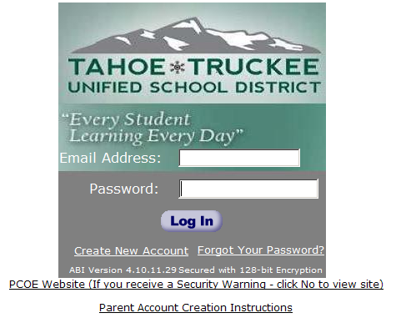
How to register On-line
AERIES
Step 1: Have or establish an AERIES account
  https://abiparent.placercoe.k12.ca.us/abi/
  Enter Your Email and Password
Notes:
If students need their verification codes in order to establish an account, please write the code in their planner. Keep your copy of the code.

Slide 17
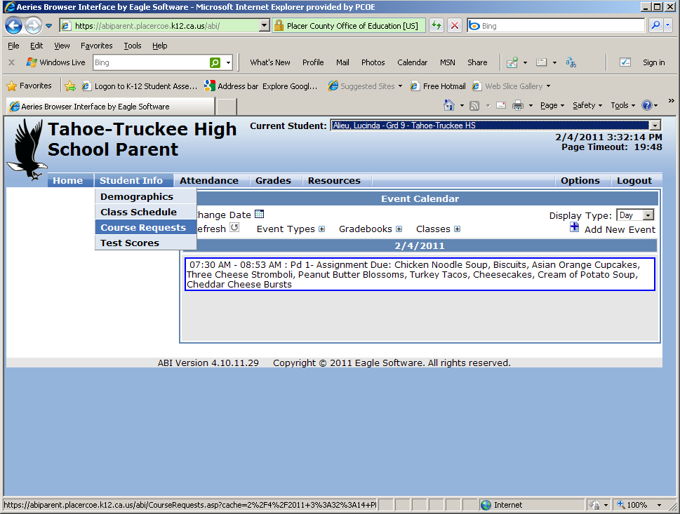
How to register On-line
Step 2: Select Student Info
  Course Requests

Slide 18
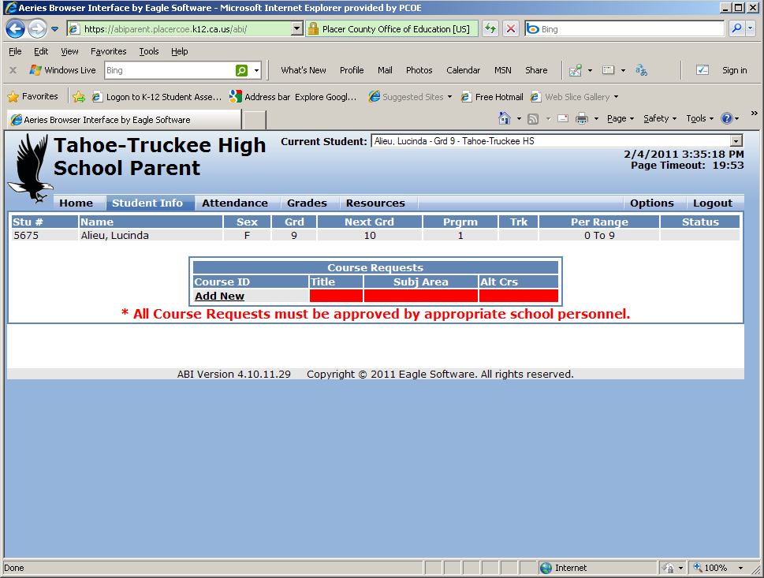
How to register On-line
Step 3: Click on ‘Add New’ – Courses available for student selection will be displayed

Slide 19
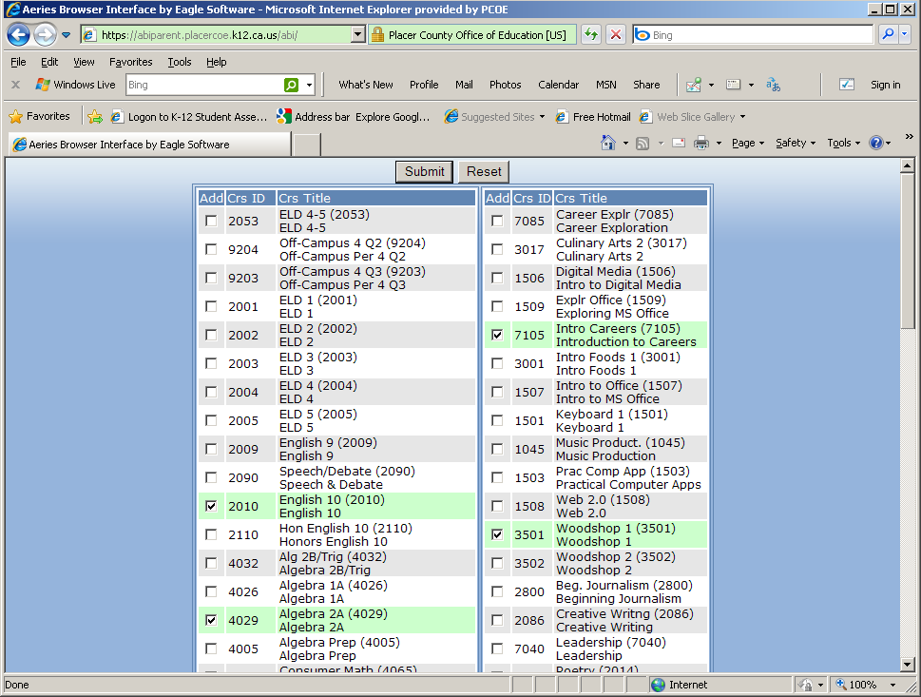
How to register On-line
Step 4: Select courses and click SUBMIT
Courses may be selected one at a time or as multiple selections.

Slide 20
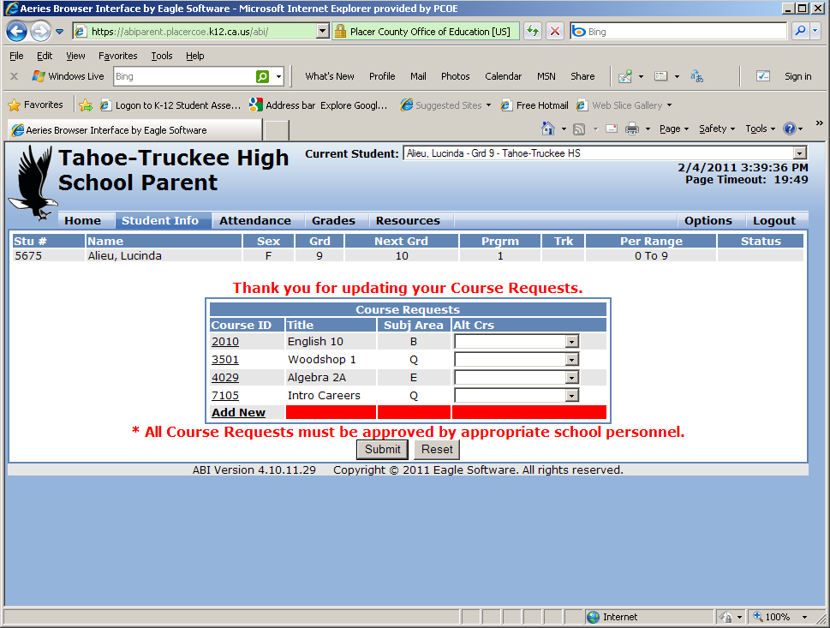
How to register On-line
Course selections will be displayed

Slide 21
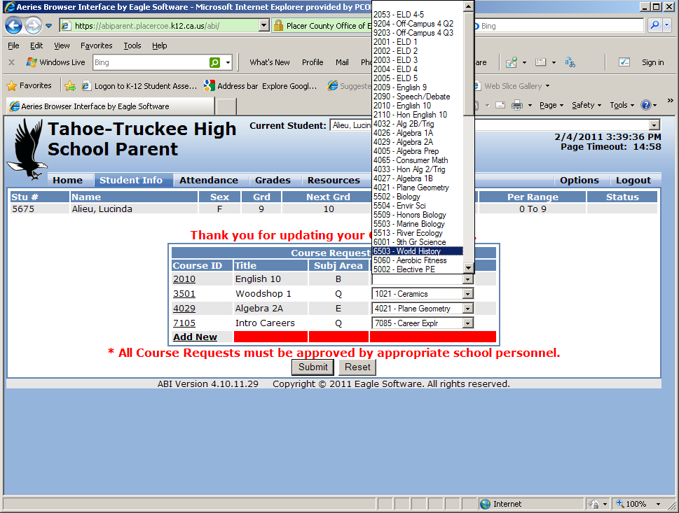
How to register On-line
Step 5: The student MUST PICK ALTERNATES for all elective classes.
Use dropdown to select an alternate course choice

Slide 22
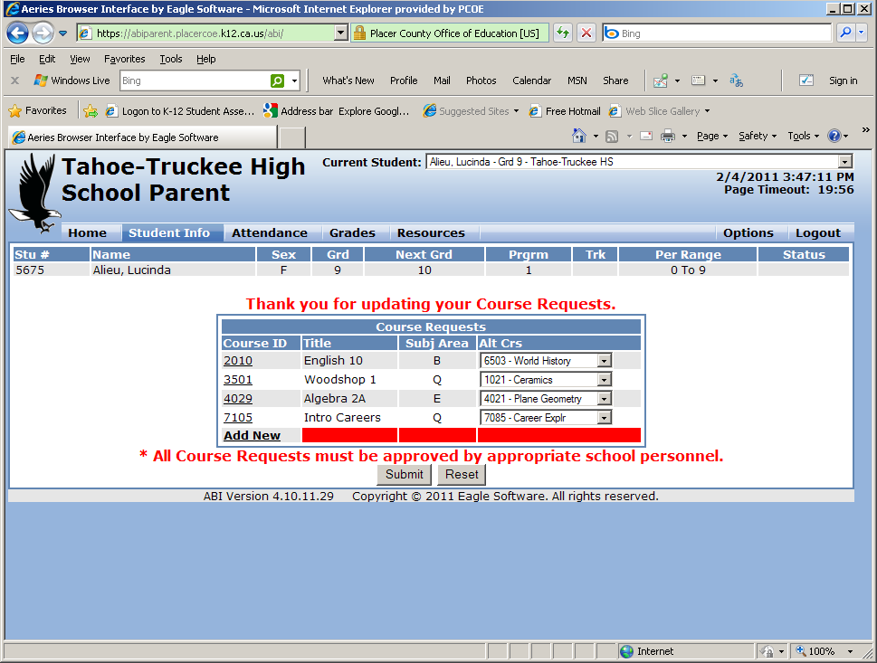
How to register On-line
Step 6: SUBMIT
Make sure to have a total of 8 semester requests and 1 alternative elective for each elective request, then SUBMIT

Slide 23
CHANGES
Course selections may be reset by using the ‘Reset’ button or updated within the registration window (FEB 16 – MARCH 18) by adding or re-selecting courses and SUBMITTING selections.
Click on the Course ID to be changed - this will take you to the course selection window.

Slide 24
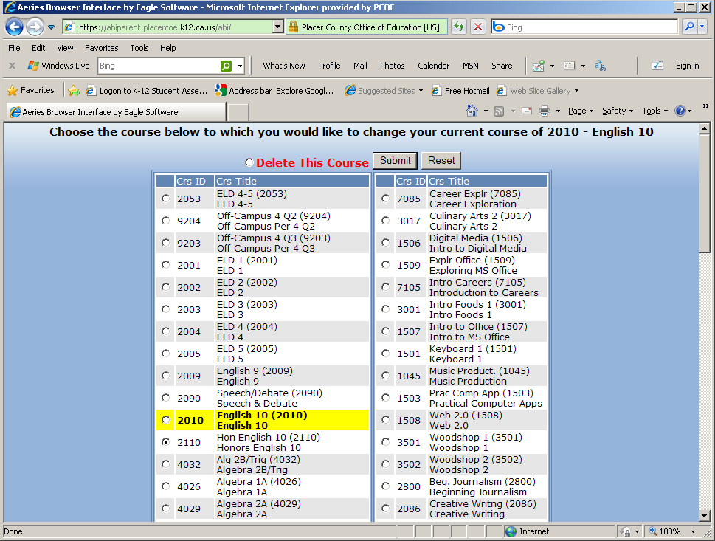
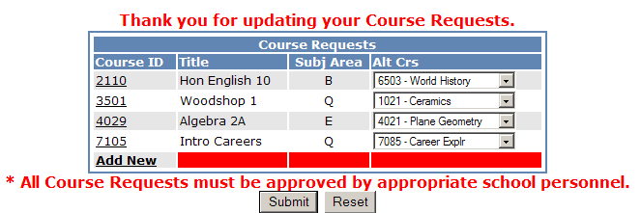
CHANGES
To change the highlighted course select the new course and SUBMIT

Slide 25
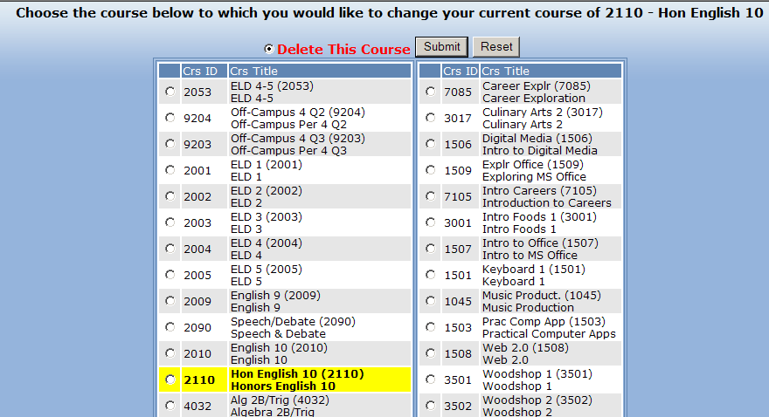
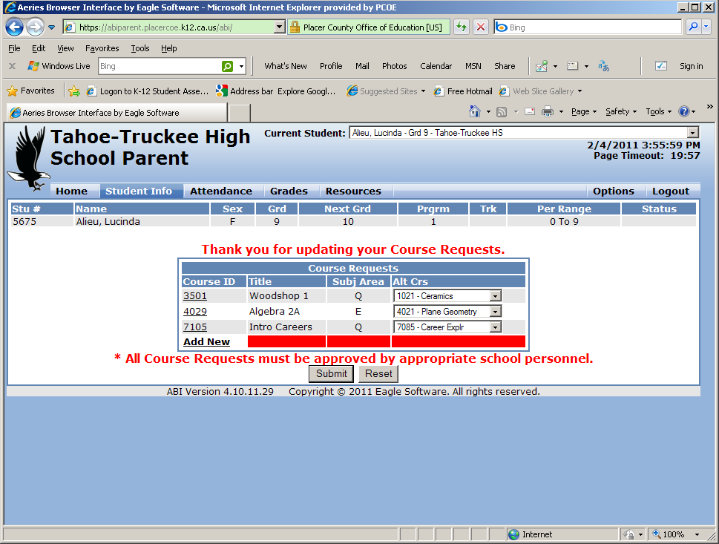
CHANGES
To remove the highlighted course click the radio button next to ‘Delete This Course’ and SUBMIT

Slide 26
Registration Timeline
Wednesday, February 16th- Registration opens
Friday , March 18th- Registration closes- Print out completed computer COURSE REQUEST SHEET and bring back to your advisory teacher with student and parent signature
Please go over your transcript and check-off list to ensure you have scheduled yourself correctly
These will be your course selections for the entire year.
Please put thought and effort into your selection. There
will be no changes except those that are teacher driven
Notes:
Teachers: There will be two special advisories, during TIRE, Wednesday, 3/2 and Thursday, 3/3 from 7:30-8:00 a.m. for all students

Slide 27
Wolverine Days- August 2011
Wolverine Days will be dedicated to:
1. PE uniform sales
2. ASB ID cards and pictures
3. Picking up final schedules
4. Getting locker number and combo
5. Yearbook orders
6. Parking permits
7. Senior Information
8. Bus Passes
9. Enrolling new students
10. Welcoming everyone back

Slide 28
CONGRATULATIONS
You are pioneers in the online scheduling process and are now finished!

